Slide 1
Color2Gray: Salience-Preserving Color Removal
Amy A. Gooch Sven C. Olsen Jack Tumblin Bruce Gooch

Slide 2
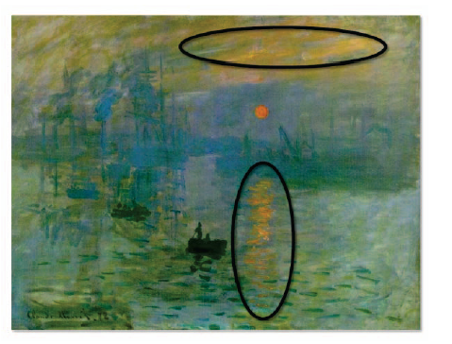
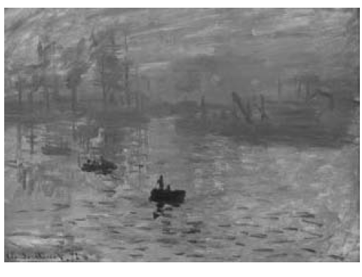

Visually important image features often disappear when color images are converted to grayscale.

Slide 3

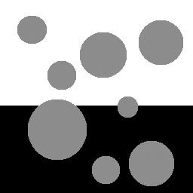
Isoluminant Colors
Color
Grayscale

Slide 4
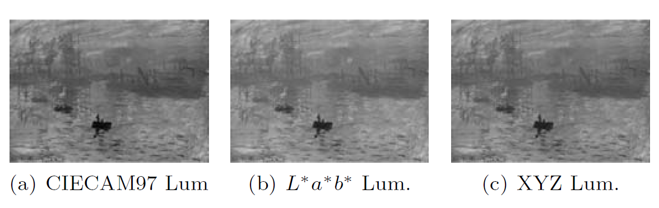
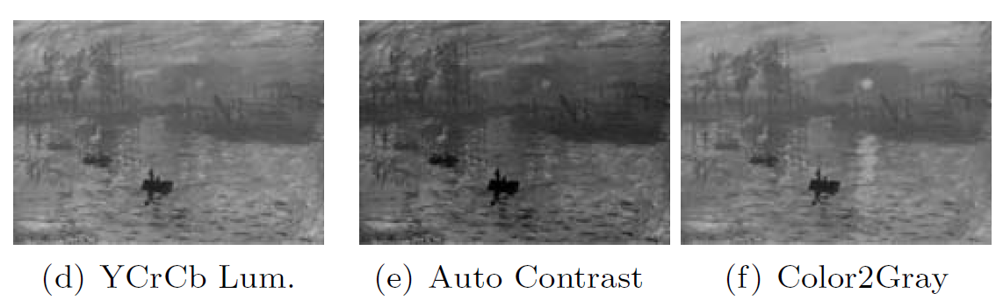

Slide 5
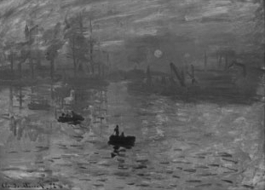
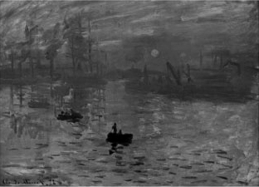
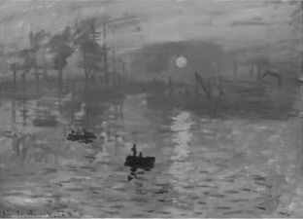
Traditional Methods
Contrast enhancement & Gamma Correction
  Doesn’t help with isoluminant values
Photoshop Grayscale
PSGray + Auto Contrast
New Algorithm

Slide 6
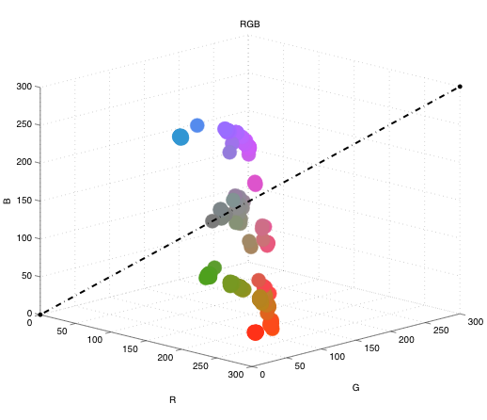
Simple Linear Mapping
Luminance Axis

Slide 7
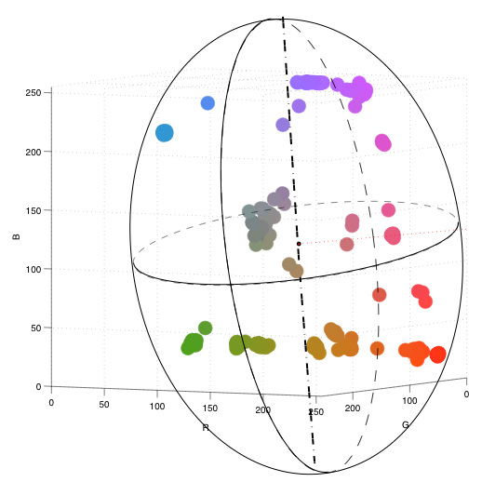
Principal Component Analysis (PCA)
Luminance Axis

Slide 8
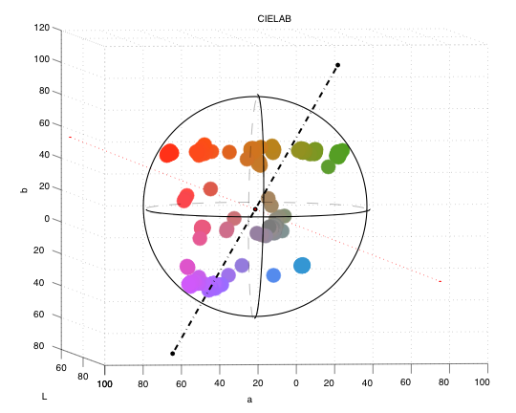
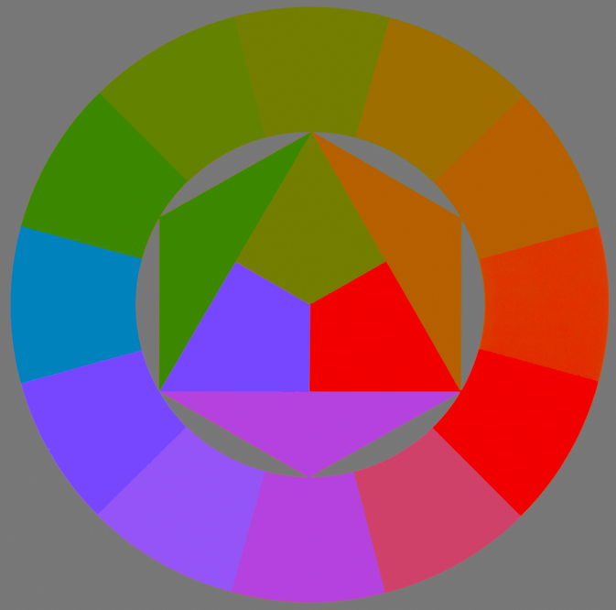
Problem with PCA
Worst case:
Isoluminant Colorwheel

Slide 9
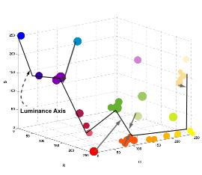
Non-linear mapping

Slide 10
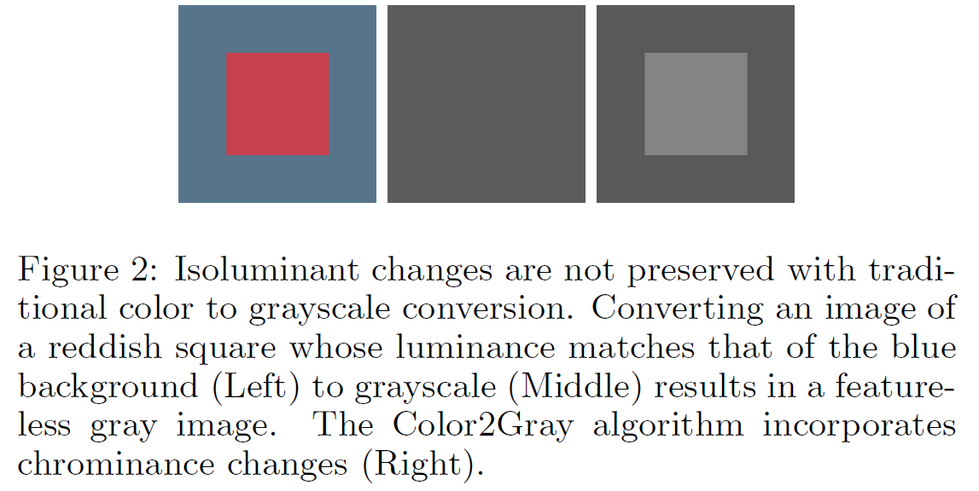
we want digital images to preserve a meaningful visual experience, even in grayscale.

Slide 11
Goals
Dimensionality Reduction
  From tristimulus values to single channel
  Loss of information
Maintain salient features in color image
  Human perception

Slide 12
Challenge:
Many Color2Gray Solutions
Original
.
.
.

Slide 13
preserve the salient features of the color image
The algorithm introduced here reduces such losses by attempting to preserve the salient features of the color image.
The Color2Gray algorithm is a 3-step process:
convert RGB inputs to a perceptually uniform CIE L∗a∗b∗ color space,
use chrominance and luminance differences to create grayscale target differences between nearby image pixels, and
solve an optimization problem designed to selectively modulate the grayscale representation as a function of the chroma variation of the source image.
The Color2Gray results offer viewers salient information missing from previous grayscale image creation methods.

Slide 14
Parameters
θ: controls whether chromatic differences are mapped to increases or decreases in luminance value (Figure 5).
α: determines how much chromatic variation is allowed to change the source luminance value (Figure 6).
μ: sets the neighborhood size used for chrominance estimation and luminance gradients (Figure 7).

Slide 15
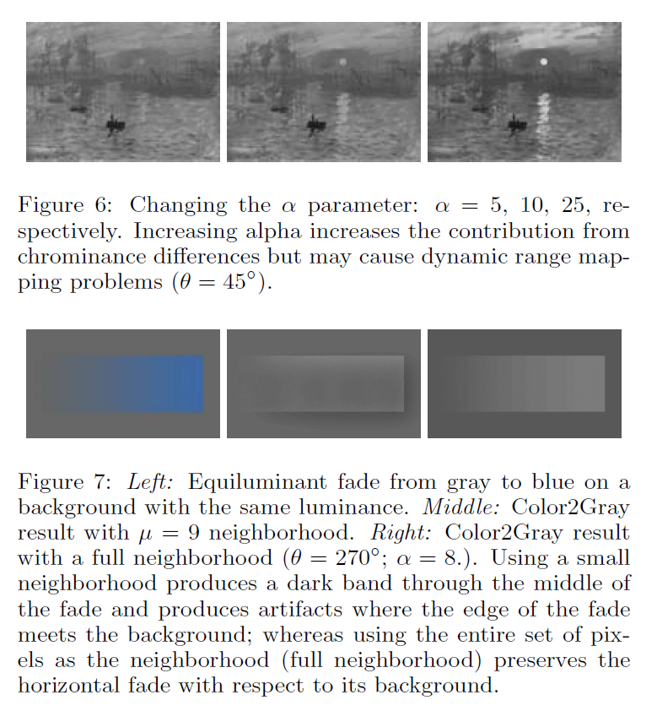
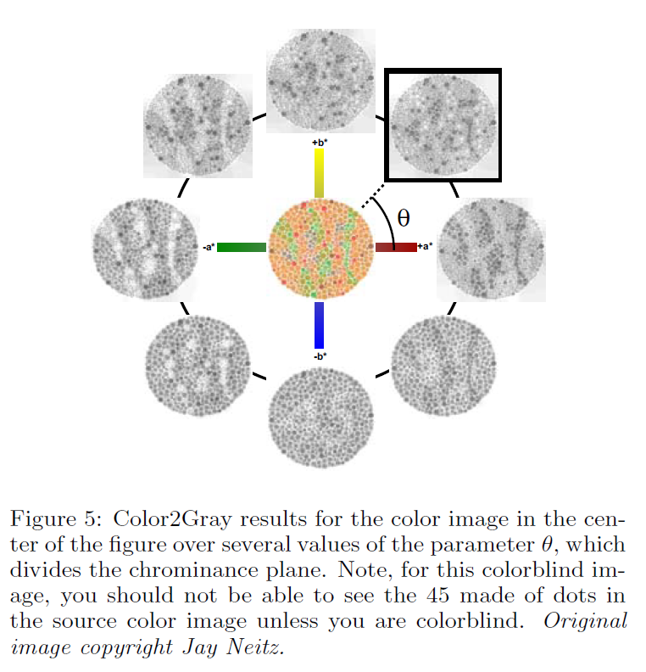

Slide 16
Map chromatic difference to increases or decreases in luminance values
+b*
C₂
-a*
+a*
Color
Space
C₁

Slide 17
Color
Difference
Space
+ΔC_{1,2}
+Δb*
v_{θ} = (cos θ, sin θ)
+
-
v_{θ}
θ
-Δa*
+Δa*
+
-
sign(||ΔC_{i,j}||) = sign(ΔC_{i,j} . v_{θ} )
-Δb*

Slide 18
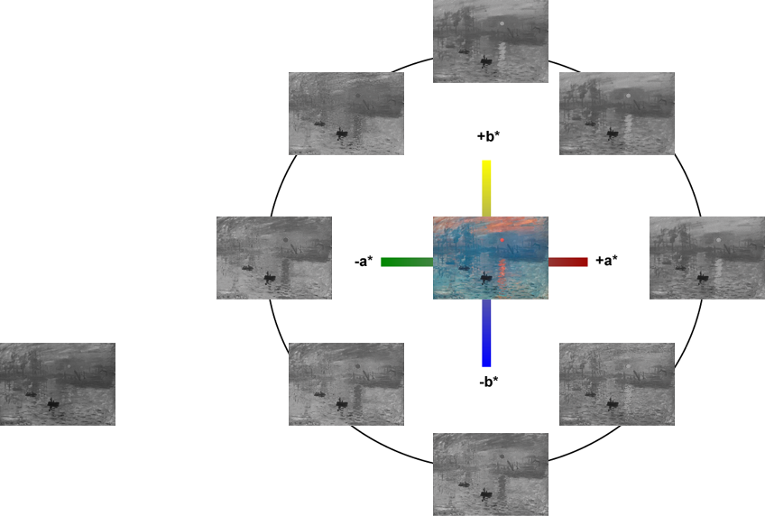
θ = 45
θ = 225
Photoshop Grayscale

Slide 19
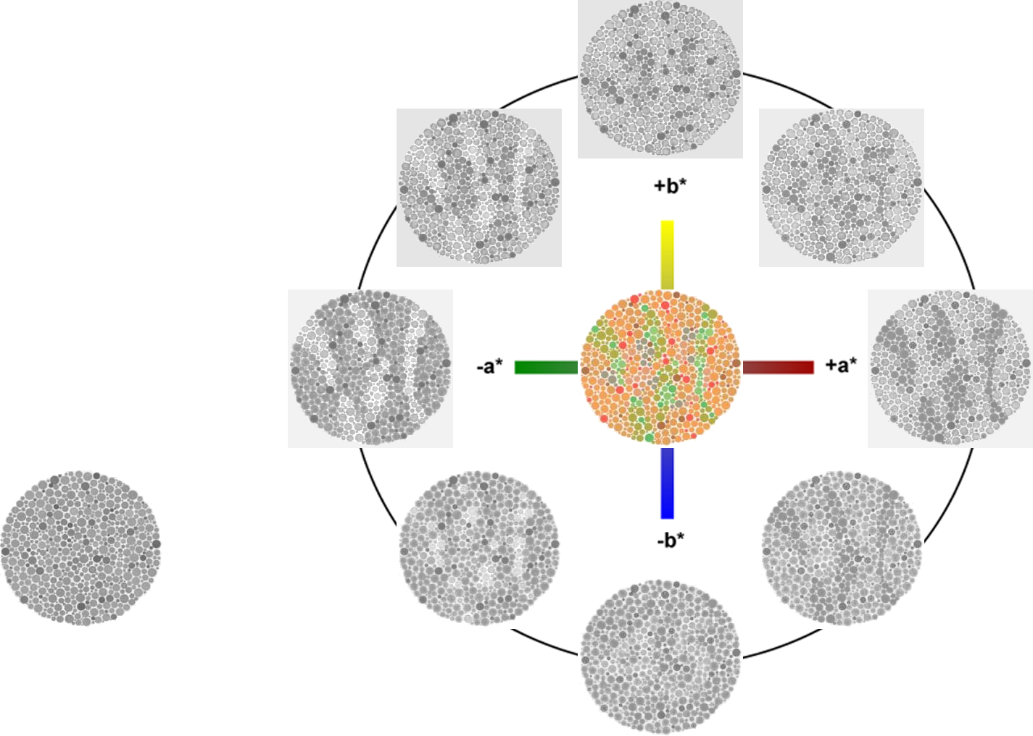
θ = 135
θ = 45
θ = 0
Grayscale

Slide 20
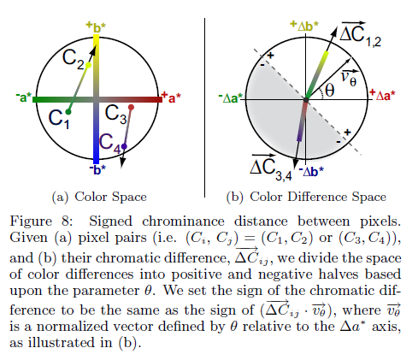
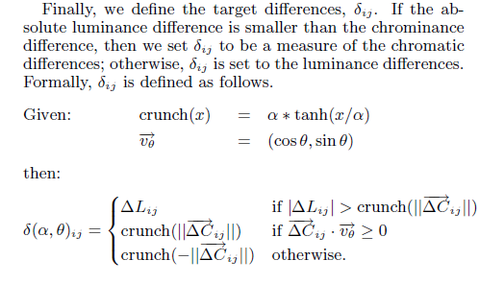

Slide 21
How to Combine
Chrominance and Luminance
δ_{ij} =
ΔL_{ij}
(Luminance)

Slide 22
How to Combine
Chrominance and Luminance
ΔL_{ij}
(Luminance)
if |ΔL_{ij}| > ||ΔC_{ij}||
δ_{ij} =
||ΔC_{ij}||
(Chrominance)

Slide 23
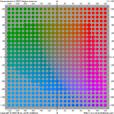
How to Combine
Chrominance and Luminance
ΔL_{ij}
if |ΔL_{ij}| > crunch(||ΔC_{ij}||)
δ (α) _{ij} =
crunch(||ΔC_{ij}||)
120, 120
100
α
−α
0
crunch(x) = α * tanh(x/α)
-120, -120

Slide 24
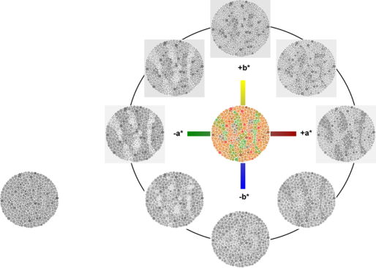
How to Combine
Chrominance and Luminance
ΔL_{ij}
if |ΔL_{ij}| > crunch(||ΔC_{ij}||)
δ(α,θ)_{ij} =
crunch(||ΔC_{ij}||)
if ΔC_{ij} . ν_{θ} ≥ 0
crunch(-||ΔC_{ij}||)
otherwise
.
.
.
Grayscale

Slide 25
Color2Grey Algorithm
Optimization:
  min Σ Σ ( (g_{i} - g_{j}) - δ_{i,j} )²
i+μ
i
j=i-μ
If δ_{ij} == ΔL then ideal image is g
Otherwise, selectively modulated by ΔC_{ij}
Notes:
Use conjugate gradient iterations to descend to a minimum

Slide 26
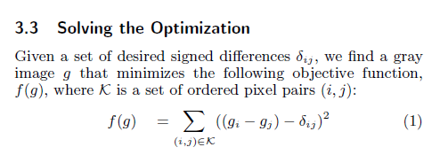

Slide 27
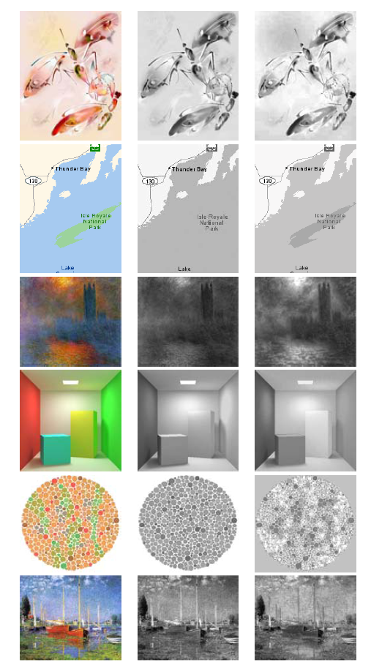

Slide 28



Validate "Salience Preserving"
Original
PhotoshopGrey
Color2Grey
Apply Contrast Attention model by Ma and Zhang 2003

Slide 29
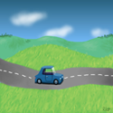
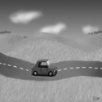
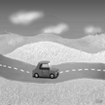
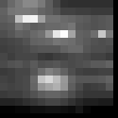
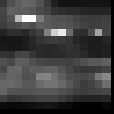
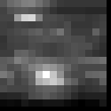
Validate "Salience Preserving"
Original
PhotoshopGrey
Color2Grey

Slide 30
IEEE TRANSACTIONS ON PATTERN ANALYSIS AND MACHINE INTELLIGENCE, VOL. 32, NO. 9, SEPTEMBER 2010
Color to Gray: Visual Cue Preservation
Mingli Song, Member, IEEE, Dacheng Tao, Member, IEEE, Chun Chen,
Xuelong Li, Senior Member, IEEE, and Chang Wen Chen, Fellow, IEEE
algorithm based on a probabilistic graphical model with the assumption that the image is defined over a Markov random field.
color to gray procedure can be regarded as a labeling process to preserve the newly well-defined visual cues of a color image in the transformed gray-scale image
three cues are defined namely, color spatial consistency, image structure information, and color channel perception priority
visual cue preservation procedure based on a probabilistic graphical model and optimize the model based on an integral minimization problem.

Slide 31
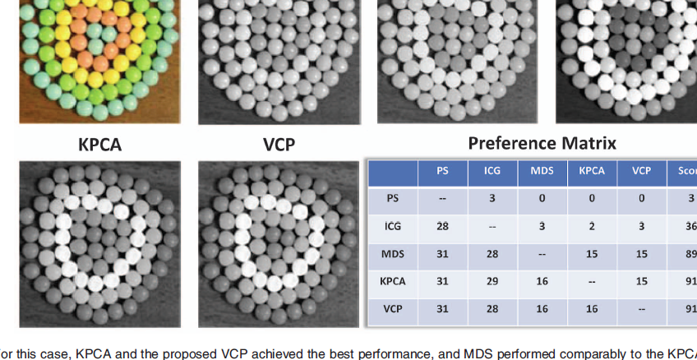

Slide 32
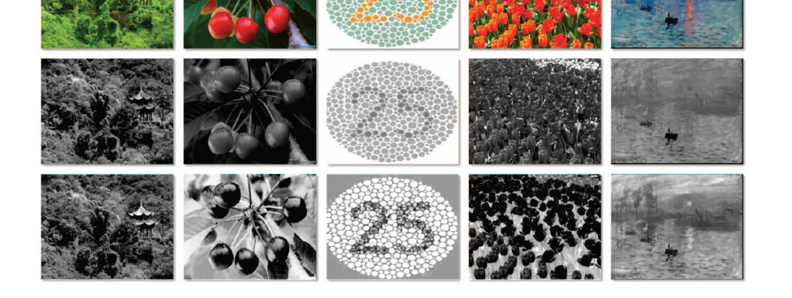

Slide 33
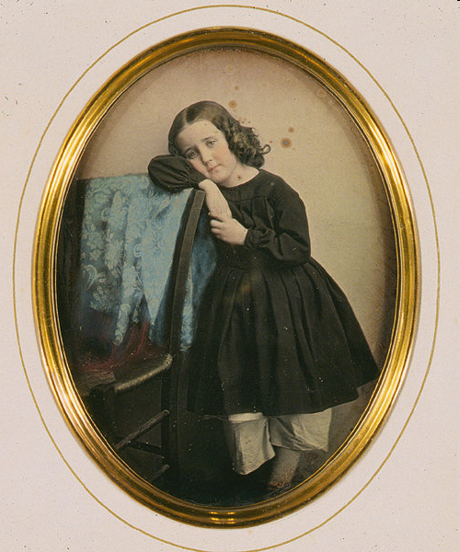
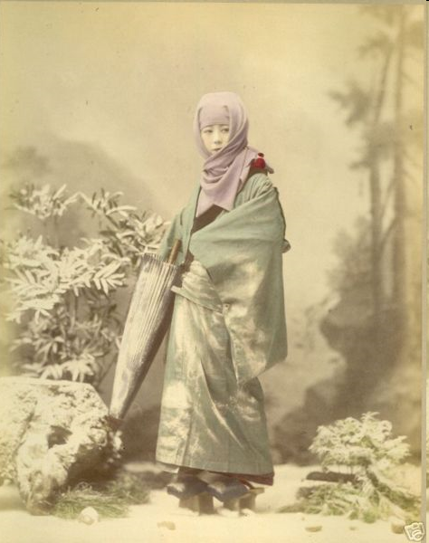
Colorization: History
Hand tinting
  http://en.wikipedia.org/wiki/Hand-colouring

Slide 34
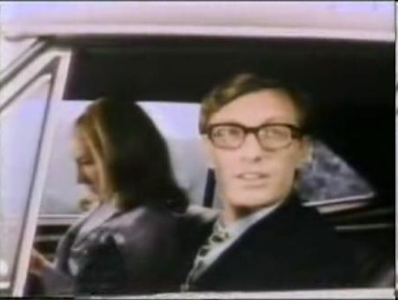
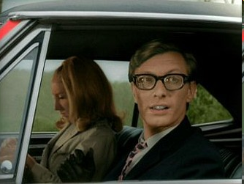
Colorization: History
Film colorization
  http://en.wikipedia.org/wiki/Film_colorization
Colorization in 1986
Colorization in 2004

Slide 35
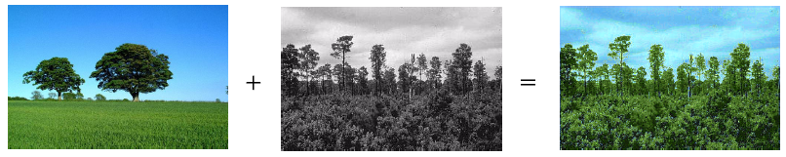
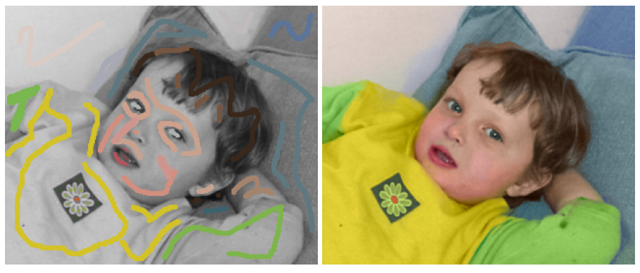
Colorization by example
Colorization using “scribbles”

Slide 36
Colorization by example
R.Irony, D.Cohen-Or, D.Lischinski
Eurographics Symposium on Rendering (2005)

Slide 37
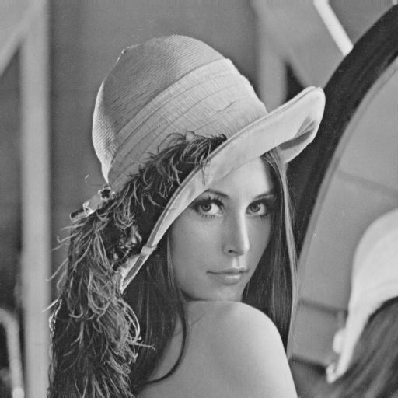
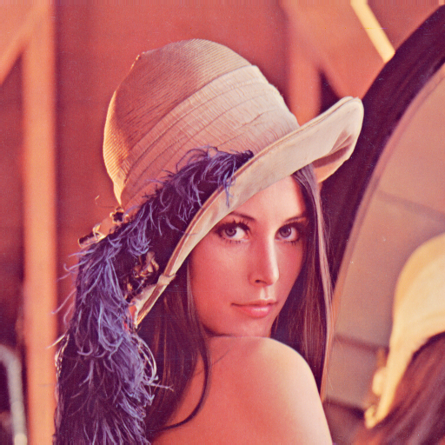
Motivation
Colorization, is the process of adding color to monochrome images and video.
Colorization typically involves segmentation + tracking regions across frames - neither can be done reliably – user intervention required – expensive + time consuming
Colorization by example – no need for accurate segmentation/region tracking

Slide 38
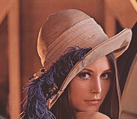
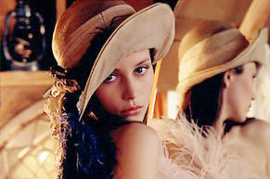
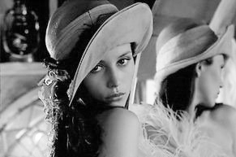
The method
Colorize a grayscale image based on a user provided reference.
Reference Image

Slide 39
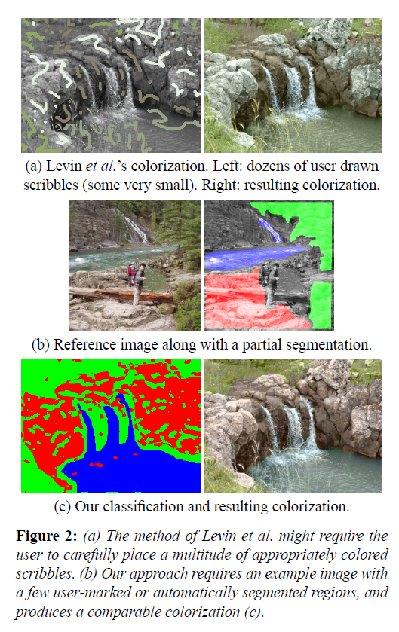

Slide 40
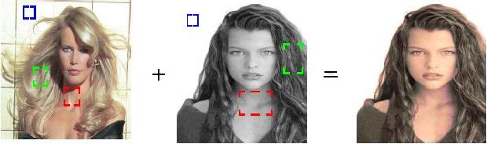
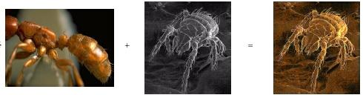
Naïve Method
Transferring color to grayscale images [Walsh, Ashikhmin, Mueller 2002]
Find a good match between a pixel and its neighborhood in a grayscale image and in a reference image.
Notes:
Hertzmann et. Al. 2001
Standard deviation of 5x5 pixel neighborhood
Match source and target based on combination of luminance (50%) and std. dev. (50%)
Map the match

Slide 41
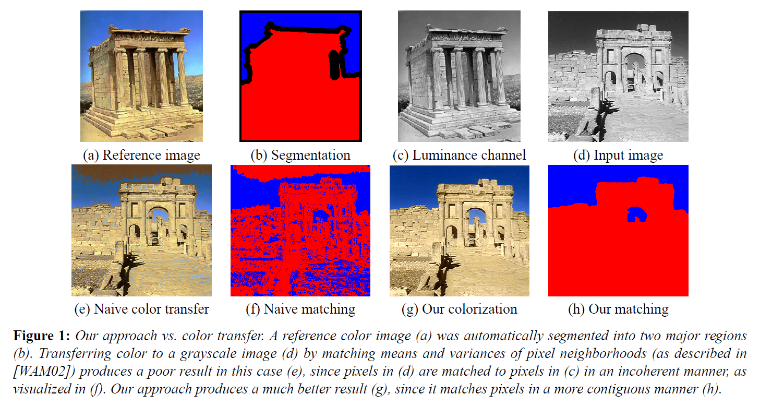
By Example Method

Slide 42
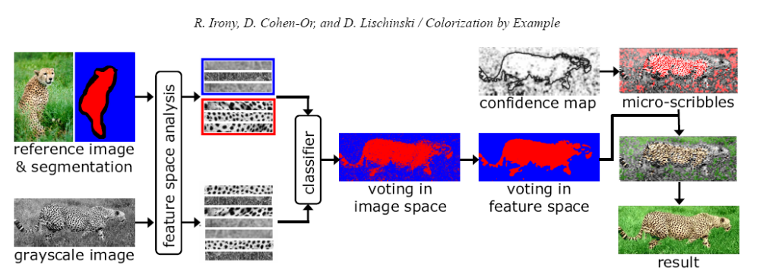
Overview
training
classification
color transfer
Notes:
we begin by analyzing the segmented reference image and constructing
an elaborate feature space, specifically designed to discriminate between different regions. Each pixel in the input image is then
classified in this feature space using voting for robustness. Then, to make the decisions more spatially consistent, we explicitly
enforce spatial consistency of colors by voting in image space, followed by a global optimization step

Slide 43
Training stage
Input:
1. The luminance channel of the reference image
2. The accompanying partial segmentation
Construct a low dimensional feature space in which it is easy to discriminate between pixels belonging to differently labeled regions, based on a small (grayscale) neighborhood around each pixel.

Slide 44
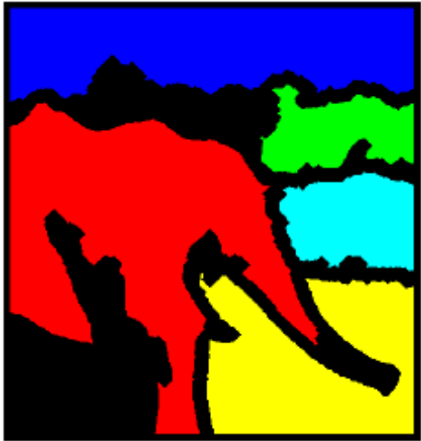
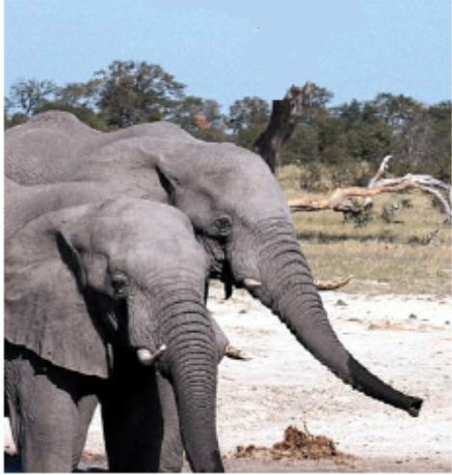

Training stage
Create Feature Space
(get DCT cefficients)

Slide 45
Classification stage
For each grayscale image pixel, determine which region should be used as a color reference for this pixel.
One way: K-Nearest –Neighbor Rule
Better way: KNN in discriminating subspace.

Slide 46
KNN in discriminating subspace
Originaly sample point has a majority of Magenta
Notes:
the feature space is populated by points belonging to two
classes: magenta and cyan. The yellow highlighted point has
a majority of magenta-colored nearest neighbors. After rotating
the space to the UV coordinate system, where V is
the principle direction of the intra-difference vectors, and
then projecting the points onto the U axis, all of the nearest
neighbors are cyan.

Slide 47
KNN in discriminating subspace
Rotate Axes in the direction of the intra-difference vector
Notes:
the feature space is populated by points belonging to two
classes: magenta and cyan. The yellow highlighted point has
a majority of magenta-colored nearest neighbors. After rotating
the space to the UV coordinate system, where V is
the principle direction of the intra-difference vectors, and
then projecting the points onto the U axis, all of the nearest
neighbors are cyan.

Slide 48
KNN in discriminating subspace
Project Points onto the axis of the inter-difference vector
Nearest neigbors are now cyan
Notes:
the feature space is populated by points belonging to two
classes: magenta and cyan. The yellow highlighted point has
a majority of magenta-colored nearest neighbors. After rotating
the space to the UV coordinate system, where V is
the principle direction of the intra-difference vectors, and
then projecting the points onto the U axis, all of the nearest
neighbors are cyan.

Slide 49


KNN Differences
Matching
Classification
Use a median filter to create a cleaner classification
Simple KNN
Discriminating KNN
Notes:
Voting is similar to a median filter

Slide 50


Color transfer
Using YUV color space
Notes:
Get all projected colors and calculate the weighted avarage

Slide 51

Final Results

Slide 52


